Slide 1
How To Detect
Job recruiting fraud
Team REAL
Danny, Allen, Tommy, Caroline, Mochi
Notes:
Danny
Hello everyone! Our presentation today is ‘How To Detect Job Recruiting Fraud’. We are Team REAL.
(introduce names by ourselves)

Slide 2
TABLE OF CONTENTS
01
02
03
04
Introduction
Preprocessing
&
EDA
NN architecture
&
Pre-trained Model
Other Findings
&
Conclusions
Notes:
Danny
This is today’s agenda.
We have background introductions, data preprocessing and some initial EDA, NN architecture and pre-trained model, also have some other interesting & related findings.
Based on what we covered, we will do a brief conclusion.

Slide 3
TABLE OF CONTENTS
01
02
03
04
Introduction
Preprocessing
&
EDA
NN architecture
&
Pre-trained Model
Other Findings
&
Conclusions
Notes:
Danny
(Let’s start with our introduction.)
（到这里最好30秒内结束）

Slide 4
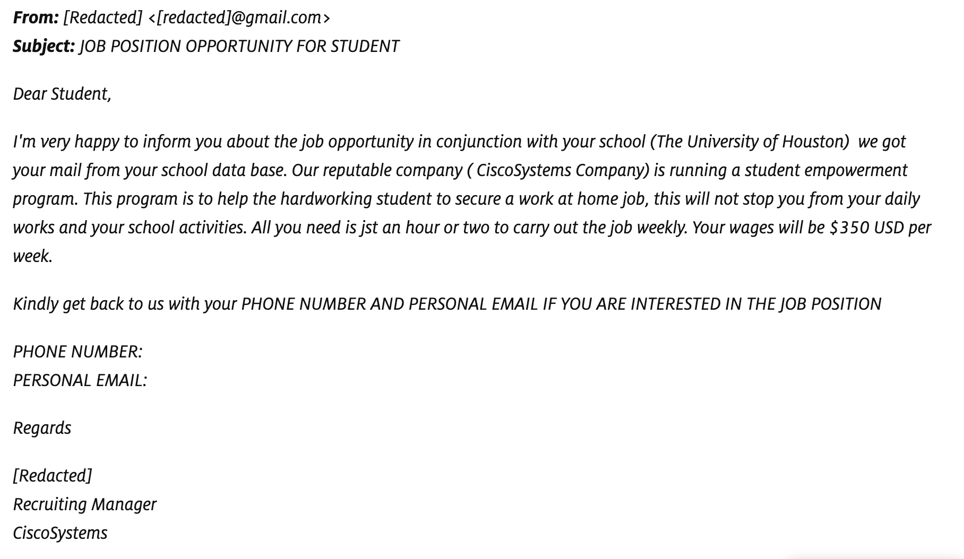
Have you ever seen this?
Job Scam!
Notes:
Danny
Have you ever seen this?
Someone sends you an email describing a quite lucrative position. Be careful! This can be job scam.

Slide 5
BAckground
The problem motivates us is the possibility of identifying fake job recruiting news
People who posted fake job recruiting news may aim at
Collecting personal information (even sell it)
Providing lucrative job opportunities and asking for money
The methods we are considering includes but not limited to:
Recognition of fake job posting by deep learning (NN) skills, including transferring text into code, model training & testing ect.
Utilize LIME, sentiment analysis to check the similarities between fake ones
Notes:
Danny
So, why are there exist fake job recruitment news?
Some of them aim at collecting personal information, even selling them; Others may aim at asking for so-called referral fee. We would like to detect those fake ones.
The methods we are considering includes but not limited to:
Text transformation
Adding different layers processing different information
Utilizing LIME, sentiment analysis etc.

Slide 6
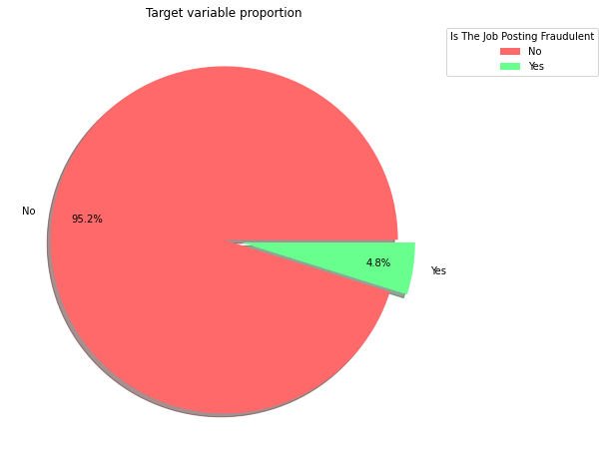
Descriptive Statistics
Is this dataset balanced?
17,879
postings
866
fake
Apparently, this dataset is unbalanced.
It contains only 4.8% fake job recruiting news, and we should keep that in mind.
The Employment Scam Aegean Dataset form The University of the Aegean (http://emscad.samos.aegean.gr/)
Notes:
Danny
Our Employment Scam Aegean Dataset is originated from the University of the Aegean. Out of over 17k entries, there are 866 are fake ones, accounted for 4.8%.
This dataset is unbalanced, we should keep that in mind.
(And I’ll pass to Allen to talk about preprocessing.)
（到这里最好1:30结束）

Slide 7
TABLE OF CONTENTS
01
02
03
04
Introduction
Preprocessing
&
EDA
NN architecture
&
Pre-trained Model
Other Findings
&
Conclusions
Notes:
Allen
(Thank you Danny)

Slide 8
Data-PreProcessing
17,879
postings
Categorical Variables
Telecommuting
Has_company_logo
Has _questions
Employment_type
Required_experience
Required_education
Text Variables
Title
Department
Company_profile
Description
Requirements
Benefits
Industry
Function
Special Variables
Salary_range
Loation
600
tokens
6 Categorical Variables - Give scales or get dummy
8 Text Variables - Combine and apply TextVectorization()
2 special variables
Salary range - Separate the range & get upper and lower bound
Location - Combine location with Text
For the missing values, we fill in numerical ones as -1, text ones with ‘unknown’
Target
Fraudulent
Notes:
Allen
Our raw dataset has 16 various features.
For the categorical ones, we gave them scale or get dummy; For the text ones, we combined them together and applied TextVectorization() to process.
We also separated the range of salary & get upper and lower bound. For the location, we added them after text.
To deal with the missing values, we fill in numerical ones as ‘-1’, text ones with ‘unknown’.

Slide 9
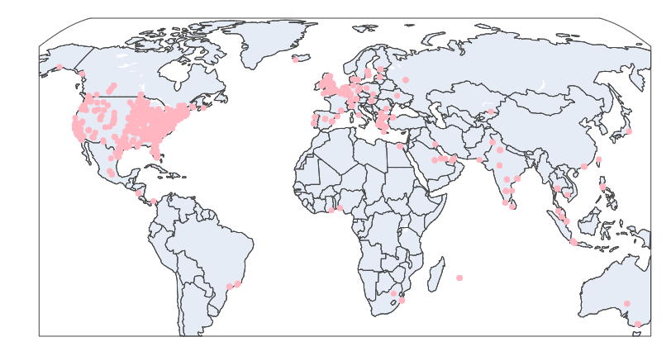
EDA - Map of location
North America
Europe
Notes:
Allen
Then we’ll introduce some primary exploratory data analysis.
This is our location map. After generating the latitude and longitude dataset of all the cities around the world, we plotted this map based on our dataset.
We can see that majority of our job recruiting posts aggregated in North America and Europe.

Slide 10
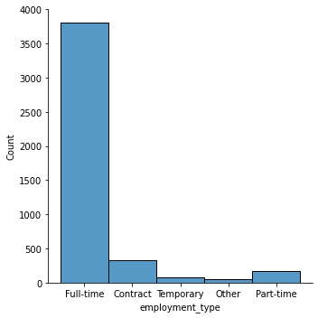
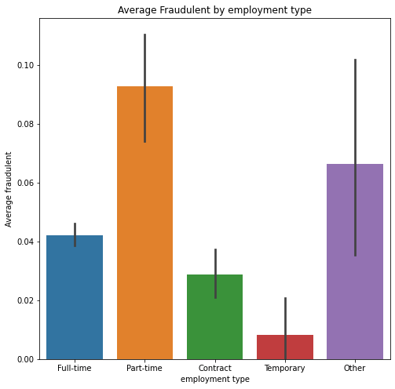
EDA - Some major categorical Features
Employment type
Avg Fraudulent by Employment Type
Notes:
Allen
We also have some analysis related to major categorical features.
On the left hand side, we have our employment type. Most of them are Full-time. By seeing the average fraudulent rate by employment type, we can see that fraudulent occurs more with part-time jobs and other unclarified jobs.

Slide 11
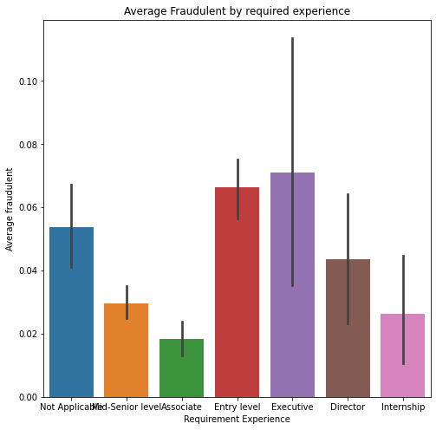
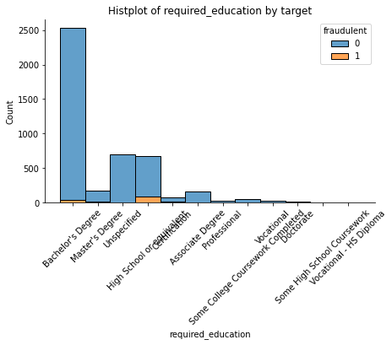
EDA - Some major categorical Features
Avg Fraudulent by Required Experience
Avg Fraudulent by Requirement of Education
Notes:
Allen
The left hand plot indicates that fraudulent occurs more often among entry-level and executive levels. Either the position is quite low, or quite high.
The right hand plot shows that fraudulent occurs more among people equipped with high-school or lower education degree. This maybe a signal that relatively uneducated group can be manipulated by fake job recruiting more easily.
(These are just our primary findings and guesses. Then I’ll hand over to Tommy and introduce our models.)

Slide 12
TABLE OF CONTENTS
01
02
03
04
Introduction
Preprocessing
&
EDA
NN architecture
&
Pre-trained Model
Other Findings
&
Conclusions
Notes:
Tommy
(Thank you Allen. Let’s dive into our models.)

Slide 13
How we prepare the layers for our model
How we deal with text
How we deal with numerical
First, we used TextVectorization() layer to preprocess our text;
Then we one-hot encoded these integer sequences but it crashed.
After preprocessing, we added another layer to deal with all the numerical values.
Notes:
Tommy
To start with, we are going to introduce how we dealt with those text and numerical values.
For the text ones, we used TextVectorization() layer to preprocess our text, which is quite common. Then we tried one-hot encoding, to pass these integer sequences but we got crashed. So basically, we just passed them directly into embedding layer.
For the numerical ones, after preprocessing, we added another layer dealing with all the numerical values.
Combining them together, let’s move to our model summary.

Slide 14
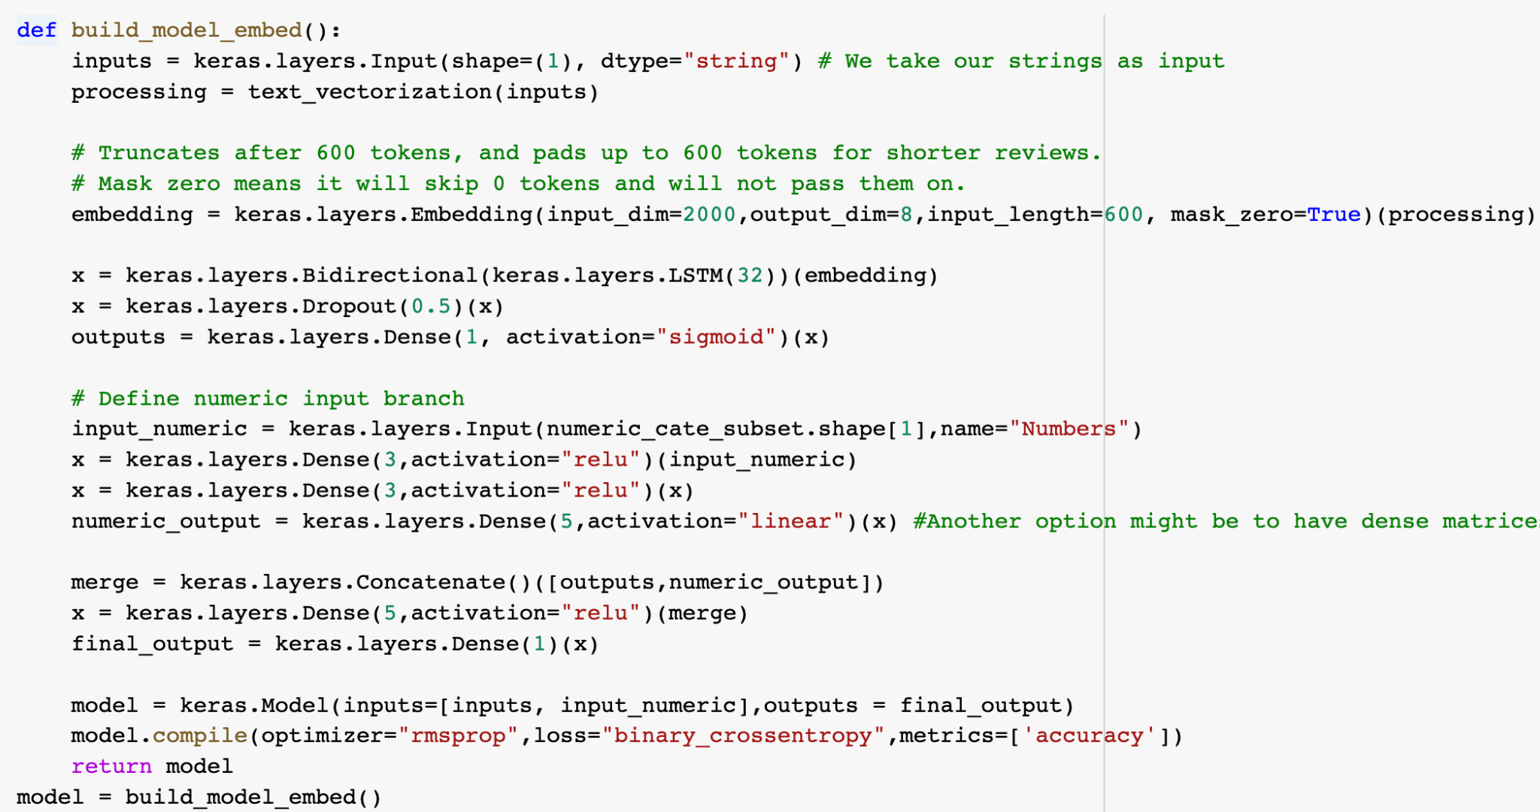
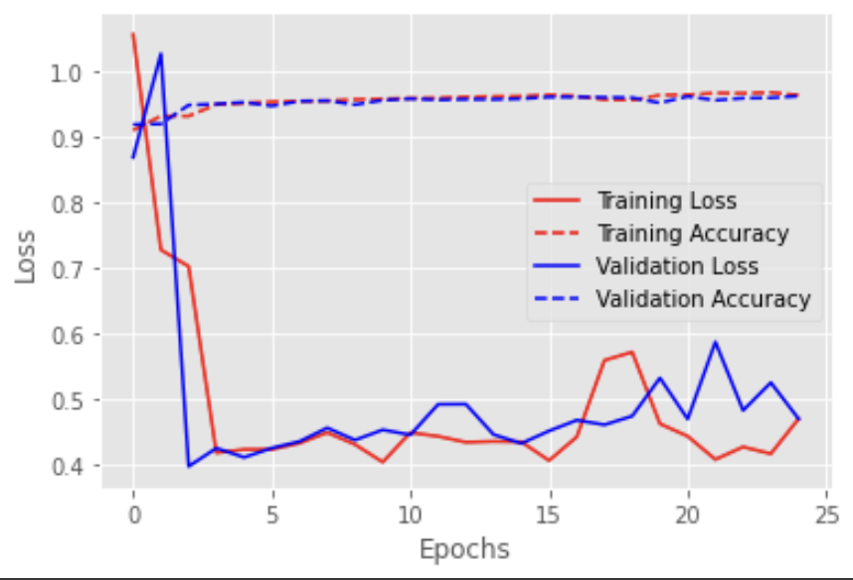
NN architecture
Model summary
Embedding layer & Numeric input
Loss function - binary_crossentropy
Train-Test Split - [:12516] (70/30%)
Cross validation - k=4
Activation - ‘sigmoid’, ‘ relu’, ‘linear’
Optimizer - Rmsprop
Dropout - 0.5
Training-Accuracy: 97.91%
Validation-Accuracy: 97.51%
Test-set Accuracy - 94.89%
Notes:
Tommy
1. use a TextVectorization() layer, with integer encoding, and then pass that into an embedding layer to reduce its dimensionality
2. we feed these sequences of vectors into our bidirectional long short term memory network. We merged the outputs for both embeddings layer and numeric input layer, and we choose binary crossentropy as our loss function
3. We split the 30% of data as our holdout samples. We also employed a cross validation in our training data

Slide 15
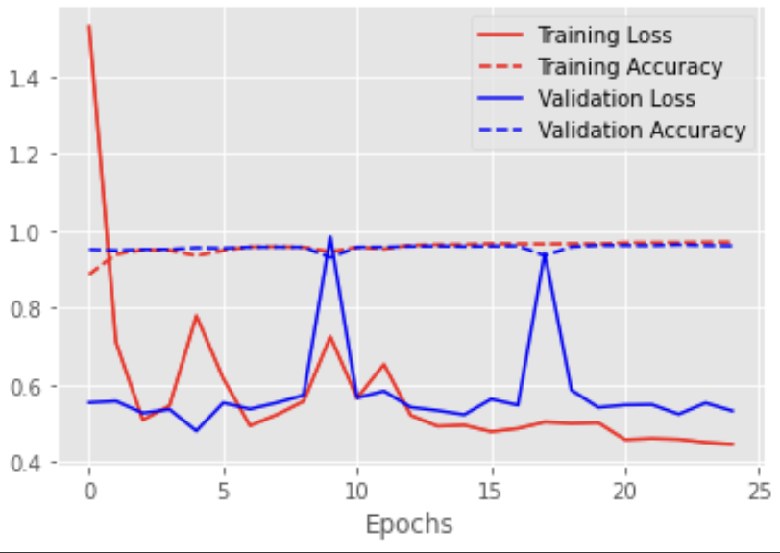
Pre-trained embeddings: glove
Model summary
Global Vector Representation
Loss Function - binary_crossentropy
Train-Test Split - [:12516]
Cross validation - k=4
Training-Accuracy: 95.09%
Validation-Accuracy: 95.24%
The resulting model is about 84.06% accurate in the holdout sample.
Notes:
Tommy
we noticed there are about 1.2 million words in the English language. We constructed the embedding matrix to map the word tokens and their vector representations
used these vector representations to instantiate our embedding layer. Rather than learning the embedding layer weight, we fit the weights to the glove embeddings, and make them non-trainable.
95.09% training accuracy and 95.24% validation accuracy. 84.06% accurate in the holdout sample.
(And I’ll pass to Caroline to talk about some interesting findings)

Slide 16
TABLE OF CONTENTS
01
02
03
04
Introduction
Preprocessing
&
EDA
NN architecture
&
Pre-trained Model
Other Findings
&
Conclusions
Notes:
Caroline
(Thanks Tommy. We also combined some other related tools to deepen our understanding.)

Slide 17
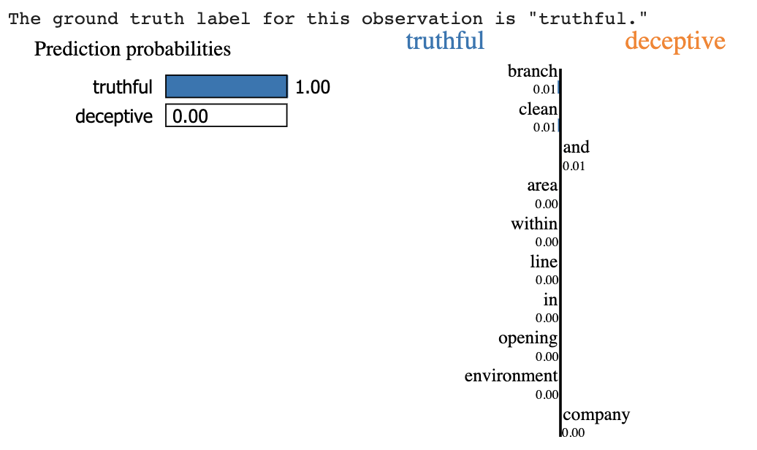
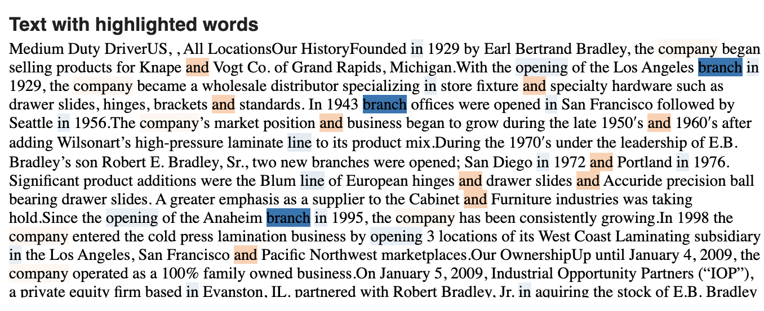
LIME
After doing a 20/80 test-train split, we trained our model processing text.
Accuracy = 98.34%
Randomly calling the one observation out, we tried multiple obs, we almost have 100% sure of predicting real job postings, around 99% probability of predicting fake ones.
Sample results showed as listed..
Notes:
Caroline
The first one we did it LIME - we would like to check the effect of text related to our model accuracy.
Like Tommy just described, we trained our model. Specifically, we focused on all the text entries. After checking the model accuracy on our test set, it turned out that we have accuracy = 98.34%, which is quite good.
Randomly calling the 14600th observation out, the ground truth label for it is ‘deceptive’.
Based on our model, we have 99% probability that we can predict the job posting is indeed fake. Results showed as above.

Slide 18
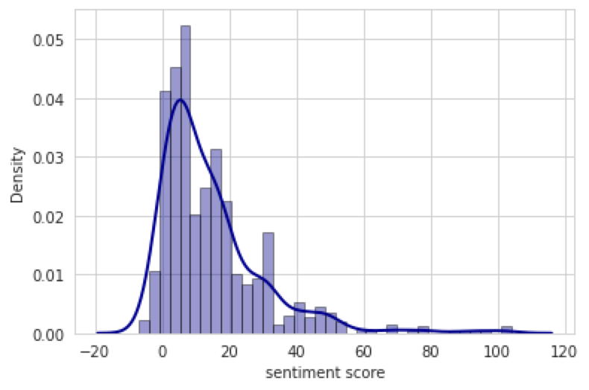
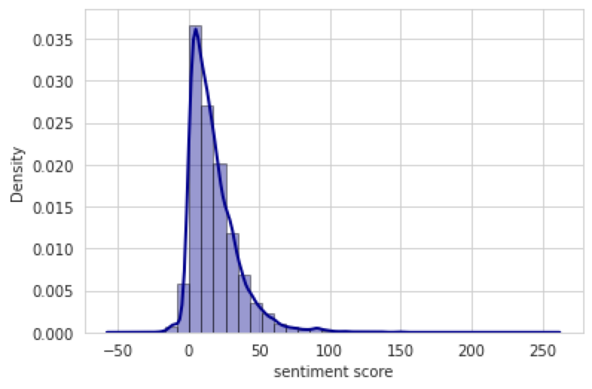
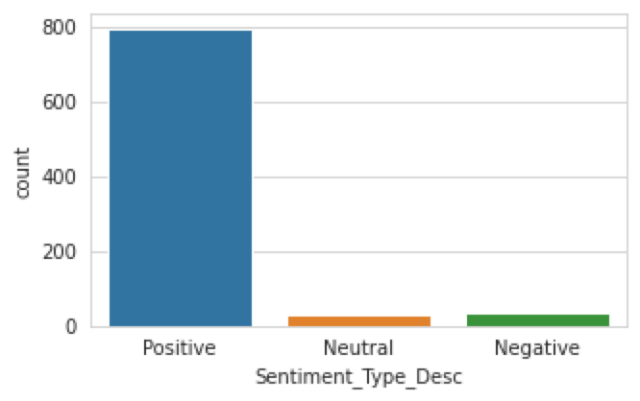
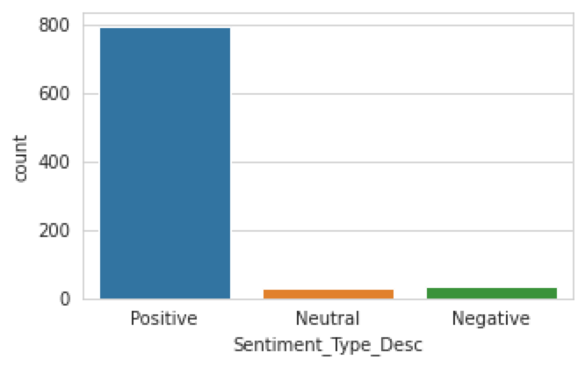
Sentiment Analysis
Fraud / Avg = 14.60
Non-Fraud / Avg = 17.98
Notes:
Caroline
We would also like to know what’s the emotional difference between real and fake job recruiting news. Our guess were that, maybe fake ones tend to talk big and give really positive nudges to job seekers. So they have much more chance of scam.
Results shows that …. So as a job seeker, when you feel xxxx, be careful! It might be a scam luring you.

Slide 19


Word cloud
Company File
Benefits
It turns out that indeed our guesses are partially right. The fake ones do tend to promise bonus and benefits, supply with online training, guarantee work life balance.
Notes:
Caroline
Lastly, we did a word cloud separately for real job postings and fake ones. We are curious that whether those fake ones promise higher salary, or focus on some specific industries.
It turns out that ….

Slide 20


Word cloud
Job Description
Job Requirements
The fake job recruiting postings tend to describe their projects or products, we may assume they are just empty talk. For the requirements, they tend to stress experience - something can not be quantified.
Notes:
Caroline
It turns out that (The fake job recruiting postings tend to describe their projects or products, we may assume they are just empty talk. For the requirements, they tend to stress experience - something can not be quantified.)
So as a job seeker, once you see essential words like xx, xx or xx, be cautious! It might be a trap.
(After all these, I’ll hand over to Mochi and do a brief conclusion. After which, we also generated some tiny suggestions.)

Slide 21
COnclusion
Model 1
Model 2
LIME
Sentiment
Word Cloud
Our self designed model has validation accuracy around 97%.
The pre-trained model has validation accuracy around 95%.
Only focused on text, the accuracy among test set is around 98%.
Fake ones tend to talk big, guarantee great welfare.
Notes:
Mochi
(All right. Let’s start with our conclusions.)
Our self designed model has validation accuracy around 97%, which is slightly higher than 95% (considering our imbalanced dataset)
The pre-trained model has validation accuracy around 95%, slightly better than our self designed one.
For the LIME, only focused on text, the accuracy among test set is around 98%.
After sentiment and word cloud, fake ones tend to talk big and guarantee great welfare.

Slide 22
Suggestions
Model
Positions
Job seekers
We tried to implement one-hot encoding processing the integer sequences, only it got crashed.
But for the first glance, the performance after one-hot is better.
For the embeddings, we can increase the depth of it (utilize more tokens).
After doing sentiment analysis and word cloud towards fake ones, we figured out that they tend to talk big about themselves, but avoid some essential information.
When seeing great welfare and work environment, be cautious.
Fake job recruiting postings tend to focus on entry level or executive level; part-time job.
Be cautious when applying for these types of positions.
Notes:
Mochi
We also generated some realistic suggestions.
Speaking of our model, We tried to implement one-hot encoding processing the integer sequences, only it got crashed. But for the first glance, the performance after one-hot is better. We may find out a way solving the GPU problem. Or for our model right now, we can also increase the depth of embeddings, to utilize more tokens.
From the perspective of job seekers, fake job recruiting postings tend to focus on entry level or executive level; part-time job. Be cautious when applying for these types of positions.
From of the features of all these fake positions, they tend to talk big about themselves, but avoid some essential information. When seeing great welfare and work environment, be cautious.

Slide 23
— Someone Famous 😉
“Think positive.
Be cautious.”
Notes:
Mochi
From all above, as a kind reminder from someone famous:
Job seekers, please think positive, but be cautious!

Slide 24
THANKS
For
listening!
Team REAL -
Notes:
Mochi
And that’s all of our presentation today. Hope you enjoyed it, and thank you for listening! 👏

